Slide 1
Orientation Fall 2022
Longwood University:
Where Technology
Meets Tradition

Slide 2
User Support Services/Help Desk
Provides technical support to students in the following areas:
Software – Virus/Malware Removal
Networking
Laptop Support – Software – Viruses/Malware
Account/Password Support
SST Program

Slide 3
Student Support Program

Slide 4
Student Support Technician (SST)
First point of contact for student technology issues
Student support desk available at the Help Desk in French Hall
Student Support Desk Hours: Monday – Friday: 9 am – 5 pm Technology Boot Camp

Slide 5
SST Program
Requirements:
GPA 2.0 Minimum
Good standing with the University
Maintain technical abilities
Friendly and excited about meeting other students!

Slide 6
Live Mail – Office 365
Each student assigned an e-mail account
E-mail address format: firstname.lastname@live.longwood.edu
Full service email account from Microsoft
Shared Calendar
Office 365 Download
www.outlook.com/live.longwood.edu

Slide 7
MyLongwood Portal
Add/Drop Classes
Check Grades
Degree Audit
Manage Student Account
Financial Aid
http://my.longwood.edu

Slide 8
Your Passwords
LiveMail
yourfirstname.yourlastname@live.longwood.edu
Password NEVER expires – you may change it at anytime if you wish
Lancernet ID and Password
Access myLongwood portal, Canvas, LancerNet wireless, computers in the labs and Library Information Commons
Expires every 120 days
Must meet complexity standards
Managed via CYPHIR

Slide 9
CYPHIR
LancerNet Password Change
Expiration
Lockout
Forgotten Password
http://password.longwood.edu

Slide 10
Internet Access - Shentel Services Residence Halls and Longwood Managed Apartments
Wireless network
Each student has a hard-wired network connection available in their room/Longwood managed apartment
A network cable will be needed to connect to the Internet in residence hall rooms. Cables can be purchased at our bookstore or a computer store of choice RJ45 to RJ45
Network Registration

Slide 11
Internet Access – LancerNet Wireless Academic Buildings - Commons Areas
LancerNet wireless is available for students in academic buildings, commons areas, and green spaces
No registration required to access LancerNet wireless
Authentication with LancerNet ID and password is required

Slide 12
The Longwood Student
Laptop Initiative

Slide 13
Windows vs. Apple?

Slide 14
Minimum Recommended Specifications
Processor: Dual Core Processor
Memory: 4GB DDR3 RAM Minimum
Hard Drive: 250GB Hard Disk Drive or 128 GB Solid State Drive
Operating System: Windows 10 or 11, MacOS 10.15 Catalina or later, or the latest stable release of a Linux distribution
External Storage Device(s): (flash drive or external hard drive)
*It is important that students bring all documentation and software that comes with their laptop when they come to campus

Slide 15
Printing
Printing is available in the academic computing labs and the Library at the rate of nine cents per page for black and white.
Pay for printing charges via Lancer CA$H.
Students may also bring a printer.

Slide 16

INFORMATION SECURITY
Longwood’s responsibility
Your responsibility
Our shared responsibility
✓

Slide 17
Respect Security Settings
Keep your firewall turned on
Keep your operating system updated
Keep your computer free of malware
Use a strong administrator password

Slide 18
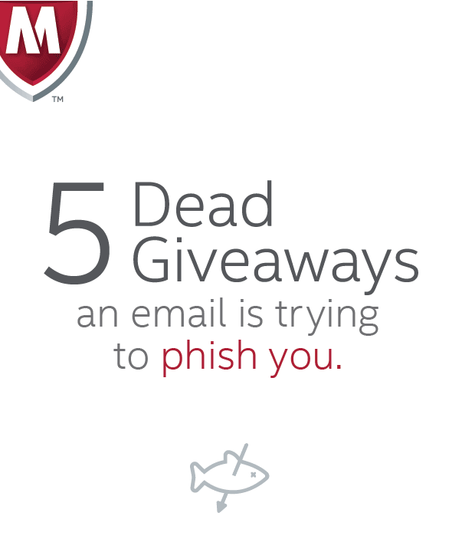
Smell the PHISHING bait
Criminals use email, telephone, or text message to ask for your identity; specifically SSN, banking info, & password
**we will disable YOUR LiveMail & LancerNet to stop criminal activity**
Notes:
Feel free to reference

Slide 19
YOUR Password
Your account is your Identity!
Do not share your password with your boyfriend/girlfriend or your best friend!
Your passwords are for your eyes ONLY!!
NO request for your password is legit. Not even from your:
Advisor
Professor
Bank
Boss
IT/Email Administrator

Slide 20
Report it
Report phishing scams/other suspicious activity
helpdesk@longwood.edu
abuse@longwood.edu
Policy Violations
will be referred to the
Office of Student Conduct & Integrity

Slide 21
Contact us for further information:
Help Desk
(434) 395-HELP
helpdesk@longwood.edu
Kim Redford
Director, User Support Services
redfordkc@longwood.edu

Slide 22
Questions??

